Slide 1
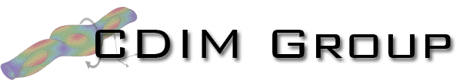

An efficient static solver for the lattice discrete particle model (LDPM)
Presenter: Alessandro Fascetti
Authors: Dongge Jia¹, John C. Brigham^{1,2} Alessandro Fascetti¹
¹ Department of Civil and Environmental Engineering, University of Pittsburgh
² Department of Bioengineering, University of Pittsburgh

Slide 2
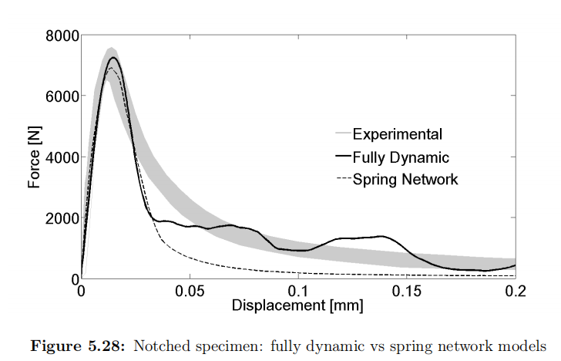
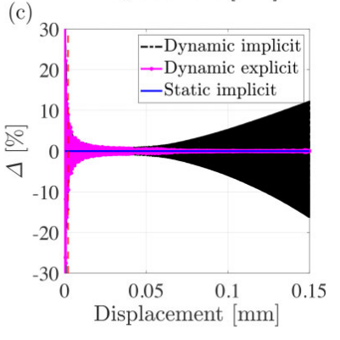
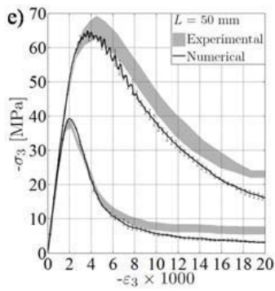
Background and Motivation
In the last decade, the lattice discrete particle model (LDPM) has become one of the most appealing computational tools to simulate fracture in quasi-brittle materials such as concrete, shale, masonry, high-performance cementitious composites, rocks, and polymers.
All LDPM-based modelling relied on the sole solution strategy: dynamic explicit algorithm with a central difference scheme.
Drawbacks of explicit dynamic solutions for quasi-static condition:
Conditional stability in elastic stage, and consequent computational demanding;
Undermined accuracy when simulating locally instable issue (quasi-brittle fracture).
Fascetti 2015
Cusatis et al. 2010
Pathirage et al. 2022

Slide 3
Objective and Innovation
The goal is to
Develop a static solver capable of solving LDPM;
Compare the computational efficiency between static solution and dynamic solution;
Enable the evaluation of the performance of dynamic solution against the equilibrium path captured by static solution.
An efficient static solver is realized by
Modification of the LDPM constitutive law to render the material response continuity;
Arc-length method with adaptive criterion to select the sign of the initial load increment factor;
Adaptive path switch mechanism to restrict oscillations in the global stiffness matrix caused by LDPM unloading-reloading rules;
Computationally efficient implementation with automatic differentiation aided by graph coloring.
Notes:
Snapshot

Slide 4
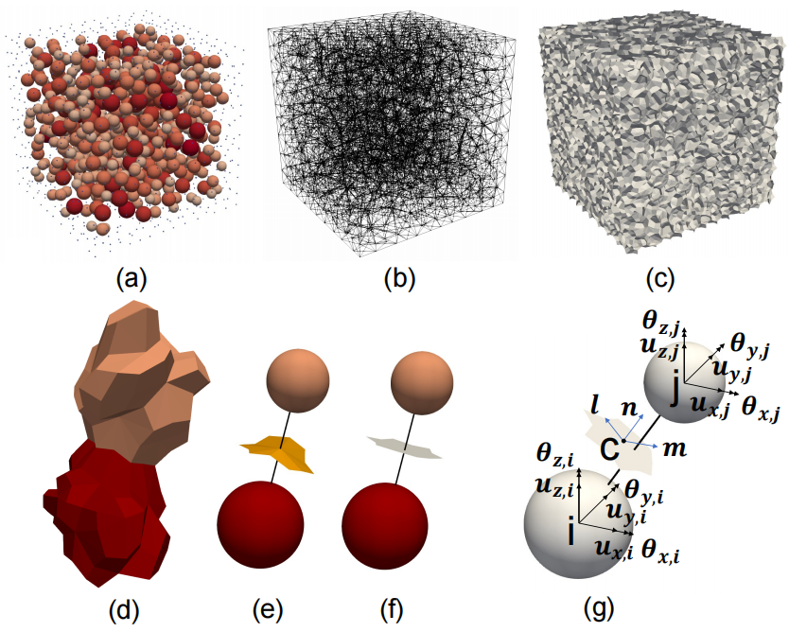
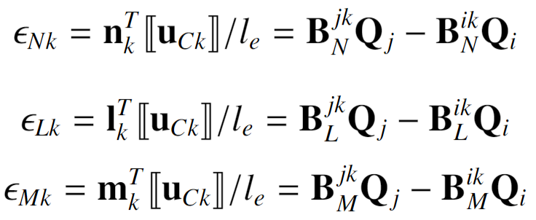
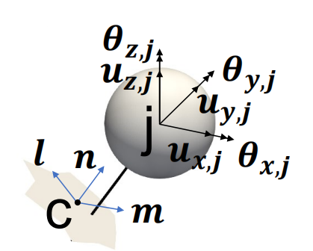
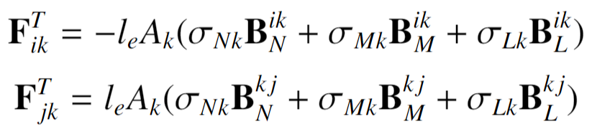
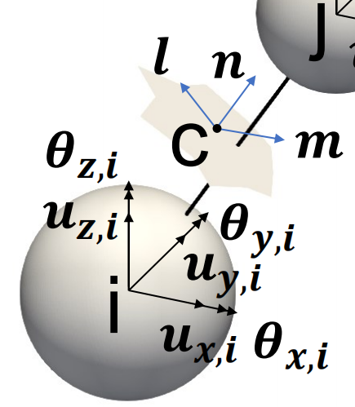

Lattice discrete particle model (LDPM)
Realistic geometrical representation of heterogeneous material (concrete)
Discrete strain compatibility and force equilibrium equations
A displacement jump is transformed into facet strains by dividing by the lattice element length:
The nodal forces at nodes i and j associated with facet k are obtained:
Summing up the nodal forces at all nodes and equating it to the external force provides the LDPM equilibrium equations.
Aggregate distribution
Delauney tetrahedralization
LDPM tessellation
$$ε⨉L$$
Two aggregates sharing (projected) contact areas
Nodal degrees of freedom and facet strain of a lattice element
Notes:
The Delaunay tetrahedralization has the property that the circumsphere of every tetrahedron does not contain any points outside of the tetrahedron.
The Voronoi tessellation is a subdivision of the volume with the property that each Voronoi cell of point p contains all locations that are closer to p than to every other point.
Perpendicularity.
equation of strain compatibility

Slide 5
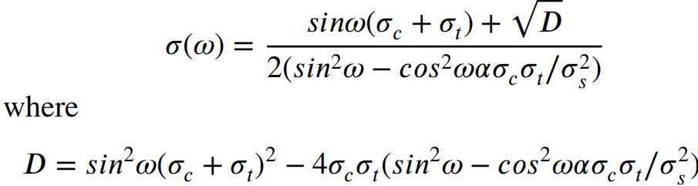
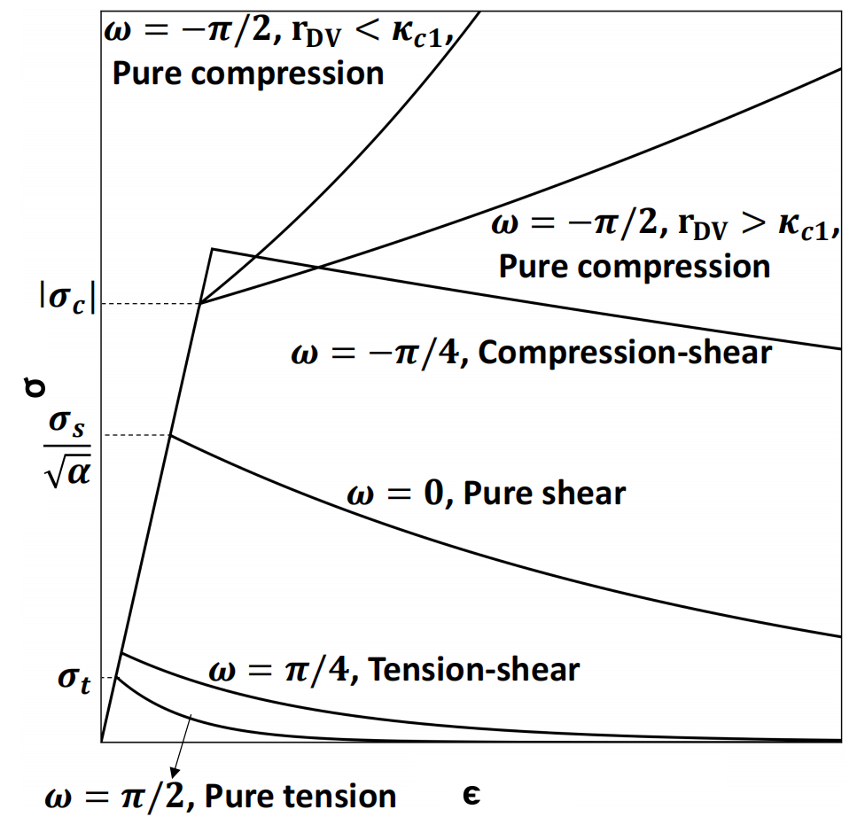
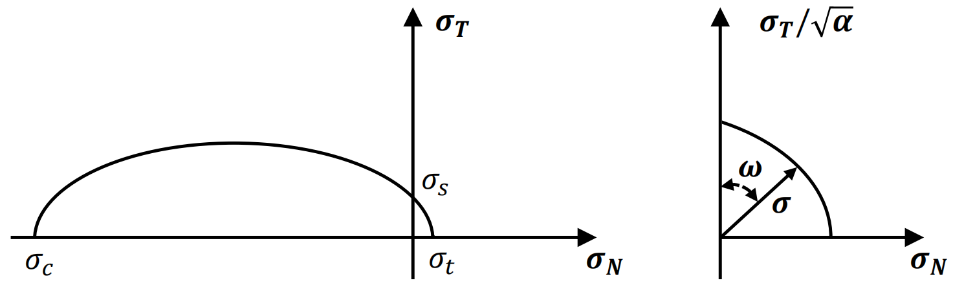
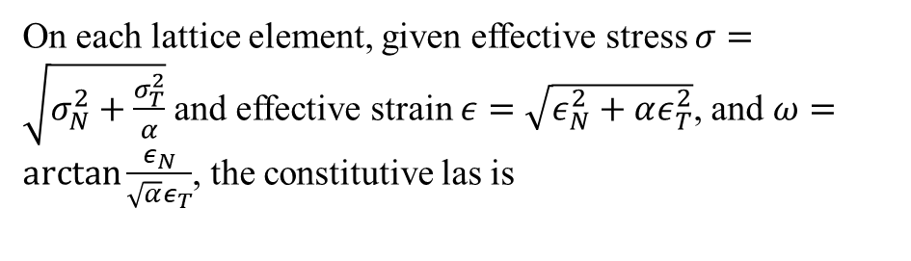
Lattice discrete particle model (LDPM)
Normal-tangential coupled lattice-level stress-strain constitutive with material response continuity
On each lattice element, given effective stress $σ=\sqrt{σ_{N}^{2}+\frac{σ_{T}^{2}}{α}}$ and effective strain $ε=\sqrt{ε_{N}^{2}+αε_{T}^{2}}$, and $ω=\arctan{\frac{ε_{N}}{\sqrt{α}ε_{T}}}$, the constitutive las is
The boundary for elastic stage is
where
Effective stress vs. effective strain under different stress states
If visualized in terms of normal and tangential stress:
Notes:
micro-scale and meso-scale pores collapse under load, and a later phase, in which the walls of completely collapsed pores are in contact leading to a significant densification of the material

Slide 6
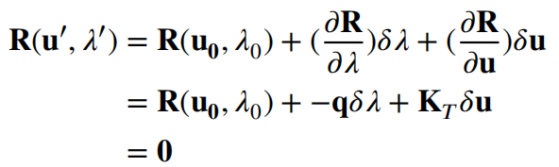
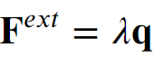
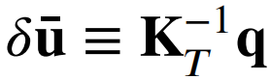
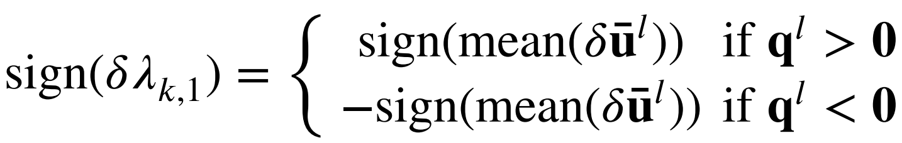
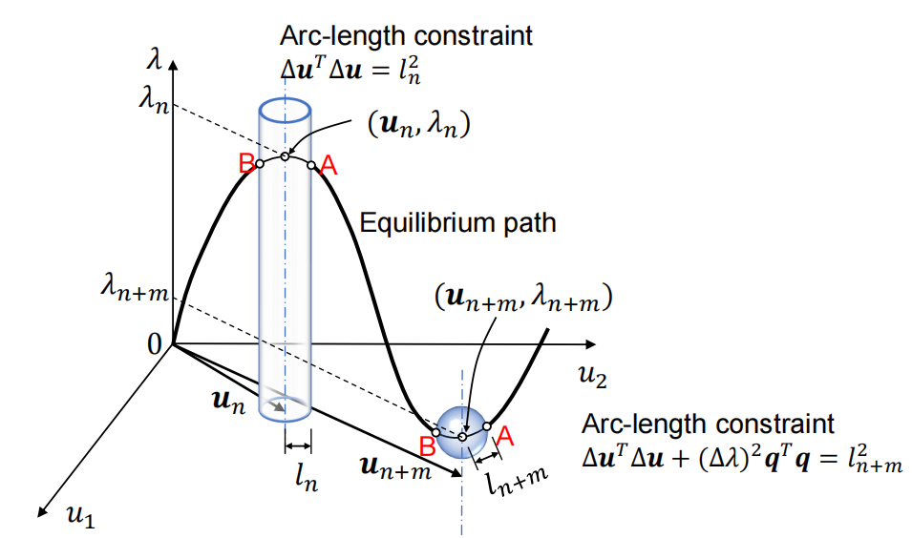
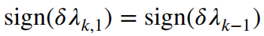
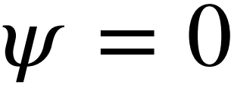
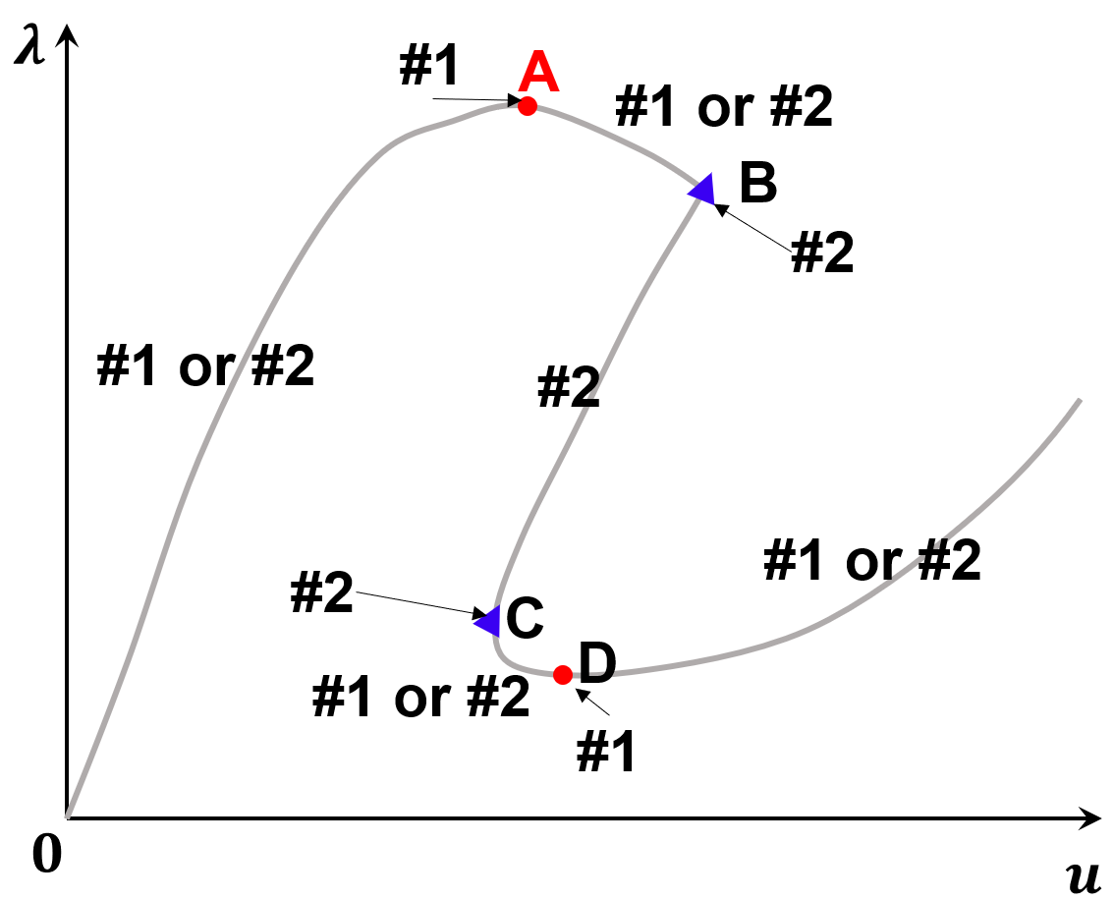
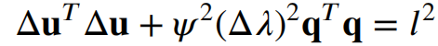
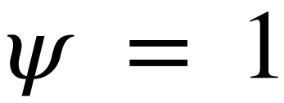
An adaptive arc-length method
First-order approximation to static force equilibrium
The proposed collaborative criterion to determine the sign of the initial increments of the load factor
Iterate both force and displacement
#1
Cylindrical
#2
Arc-length constraint
Spherical
Notes:
The logic behind the proposed criterion is to choose the correct value of 𝛿𝜆𝑘,1, so that the loaded nodes move in a direction consistent with the external load.
monotonic variation of the load factor independent of displacement change:

Slide 7
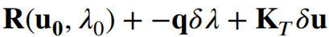
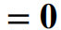
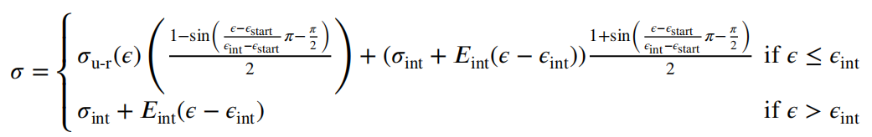
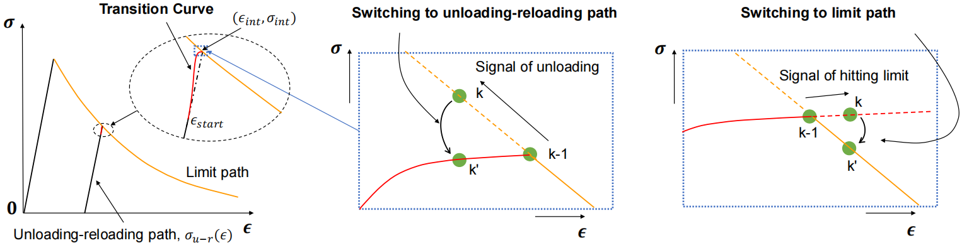
An adaptive arc-length method
For a more continuous Jacobian in
A trigonometric parametric transition curve bridging the unloading-reloading path and the strain-softening branch:
Adaptive path switch:
After the completion of each increment, elements are checked to determine whether their constitutive paths are transitioning between limit paths and unloading-reloading paths, and the stress-strain paths will be switched accordingly

Slide 8
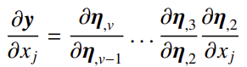
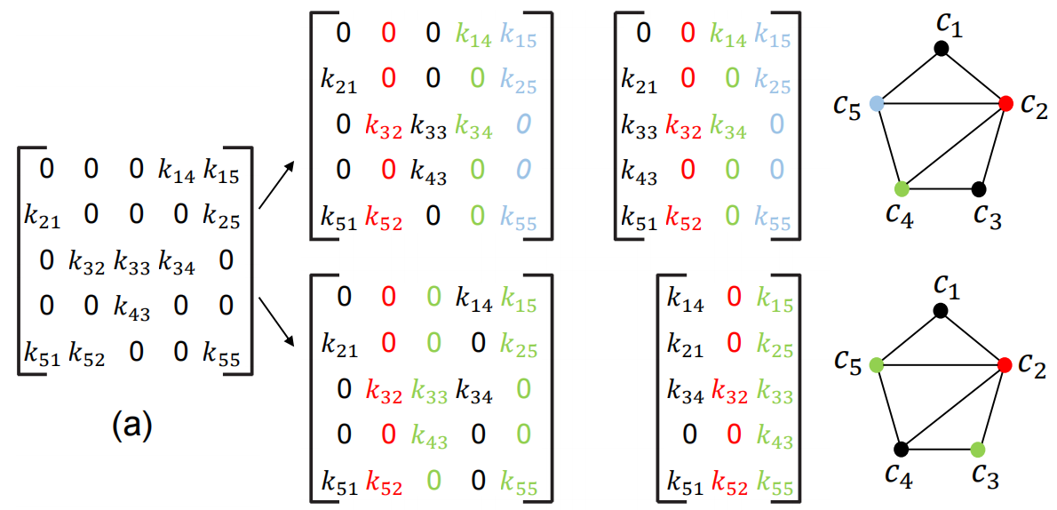
Computationally efficient implementation
Automatic differentiation (AD) with distance-1 graph coloring
The number of required AD passes can be decreased by aggregating multiple independent passes together to allow for the computation of compressed fuller columns (or rows) (Gebremedhin et al. 2005).
(forward mode AD)
To find the coloring scheme that produces the lowest possible number of compressed columns:
Greedy algorithm: assign each vertice
to a sequence number of color that has already been used as much as possible (Curtis et al. 1974).
Largest-first (LF) ordering: organize the vertices in a manner in which the degree of each vertex —representing the number of edges connected to the vertex — is arranged from the largest to the smallest (Welsh and Powell 1967).
Original sparse Jacobian matrix
Two possible aggregations
Column intersection graph in which adjacent columns have different colors
Notes:
accurate to machine precision
NP Complete problem
nondeterministic polynomial time

Slide 9
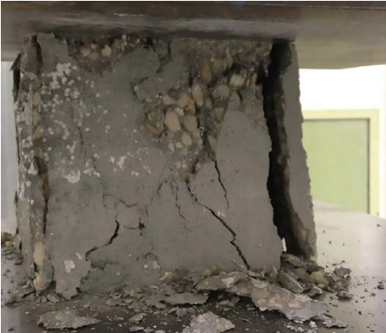
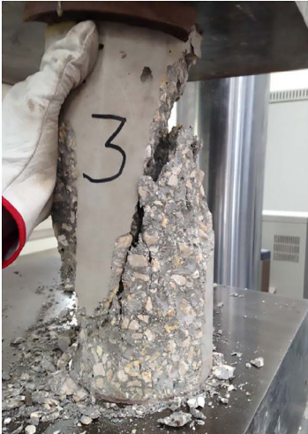
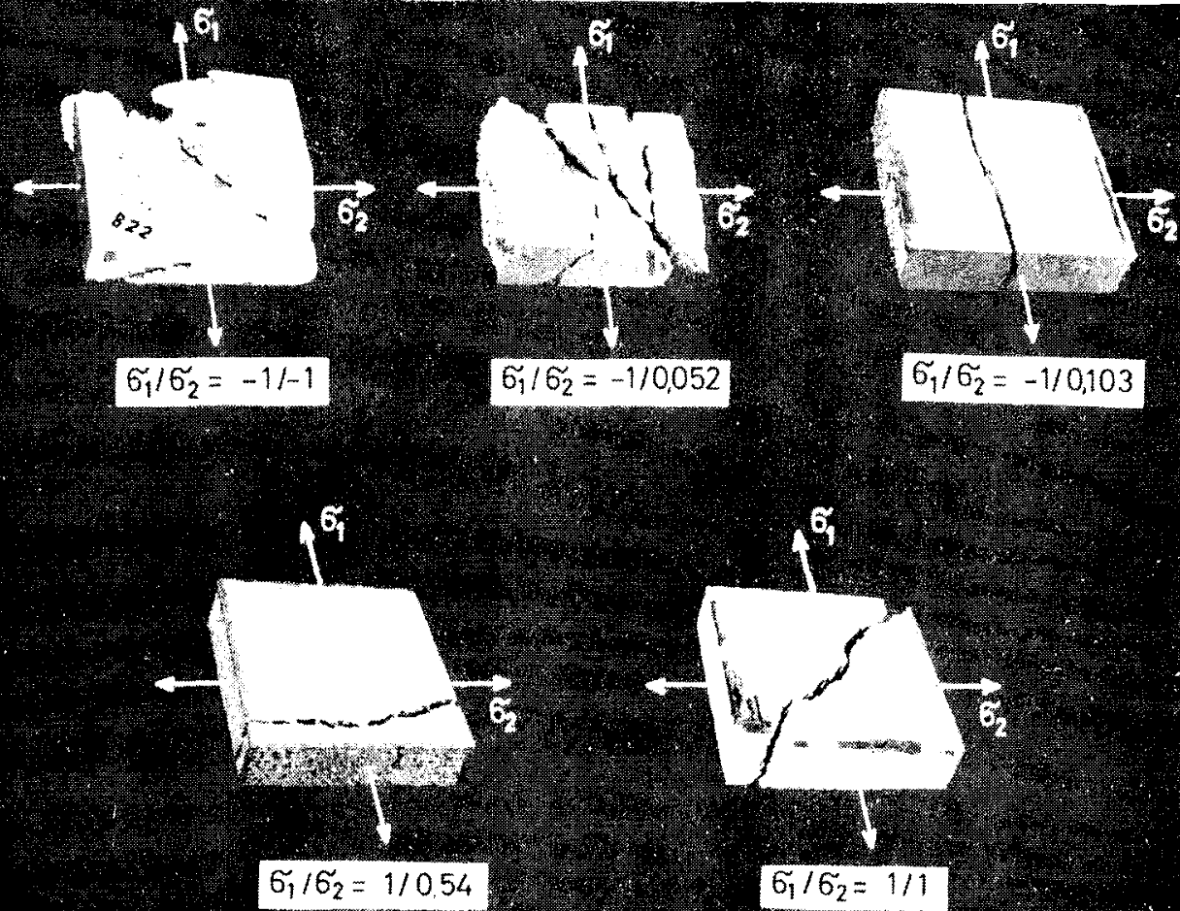
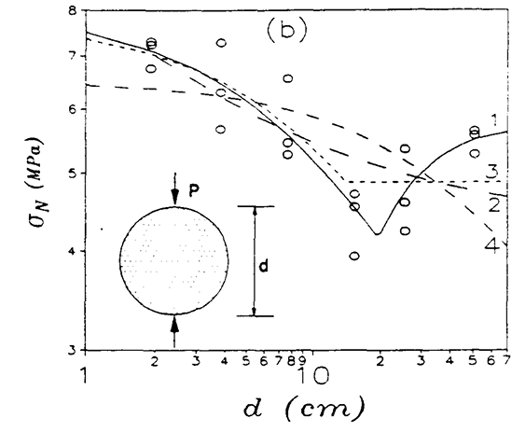
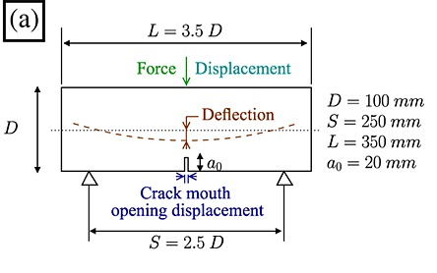
Numerical Results
Concrete experiments used for validation and evaluation:
1 1. Unconfined compression
(Fascetti et al. 2016)
2. Biaxial fracture
(Kupfer et al. 1969)
3. Tensile splitting
(Bazant et al. 1991)
4. 3-point bending
(George et al. 2013)
Notes:
aesterisk

Slide 10
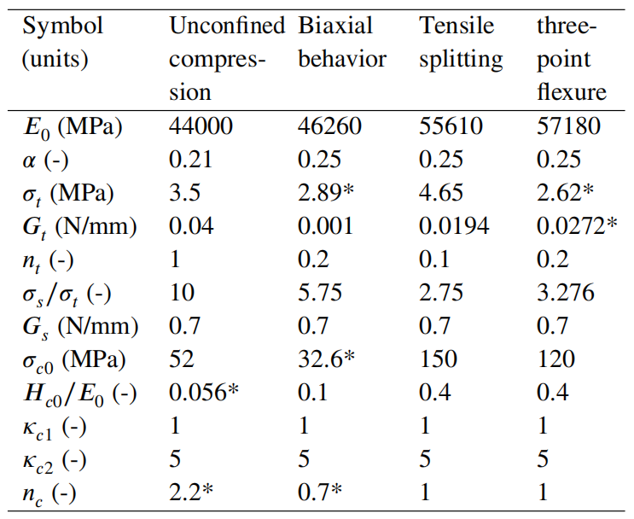
Numerical Results - Parameter Calibration
Parameter calibration
Geometry parameters:
1. Use those already published in the literature.
Mechanical parameters:
1. Choose the values of parameters that already being calibrated in literature;
2. Calibrate a few parameters that have new definition if necessary.
Values of constitutive parameters used in the numerical simulations
Note: superscript * indicates calibrated values
Notes:
aesterisk

Slide 11
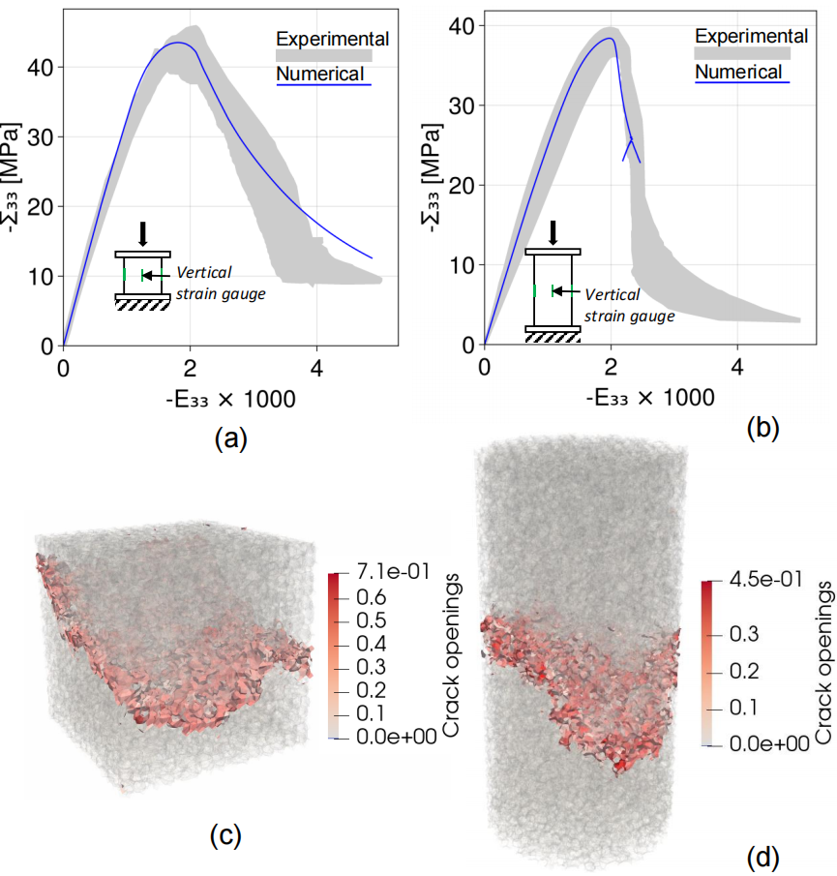
Numerical Results - Validation
Cubic sample
Cylindrical sample
Parameter calibration
Validation
Unconfined
Compression
Tested data are from Fascetti et al. (2016)
Stress-strain response
Cracking pattern

Slide 12
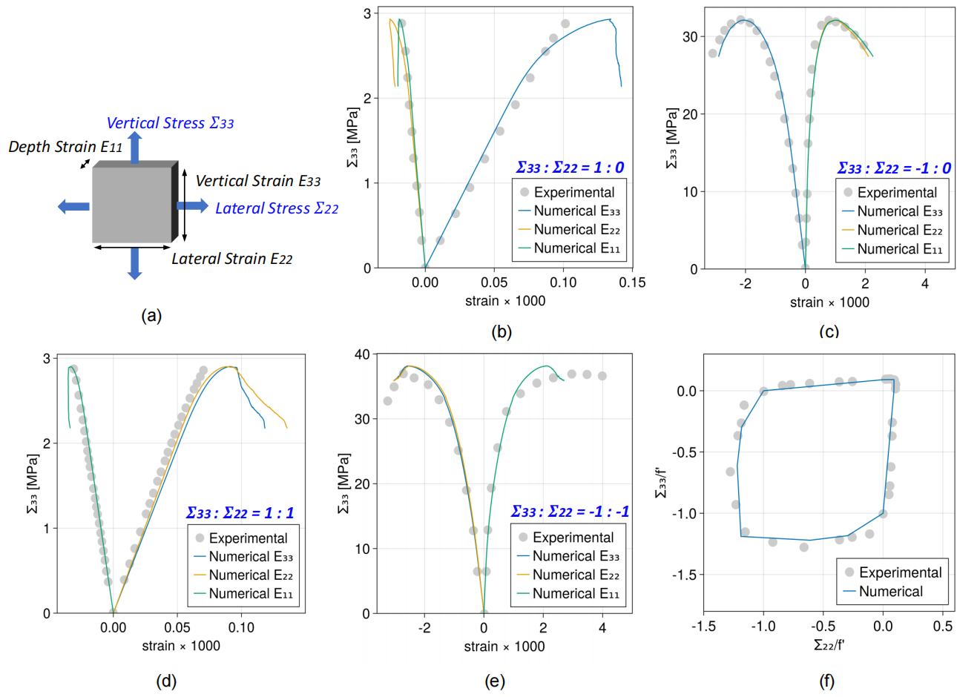
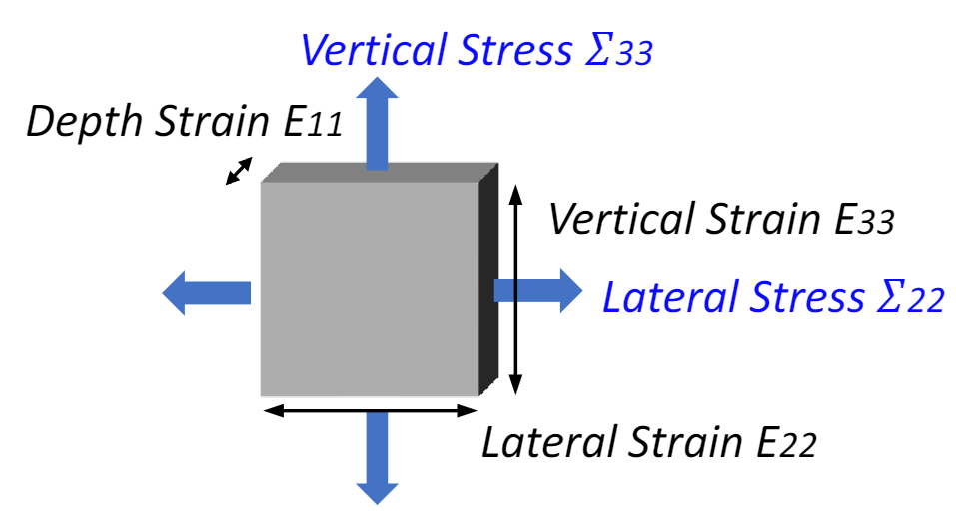
Numerical Results - Validation
Biaxial behavior – stress-strain response
Tested data are from Kupfer et al. (1969)
Parameter calibration
uniaxial compression
uniaxial tension
Validation
biaxial compression
biaxial tension
biaxial failure envelope

Slide 13
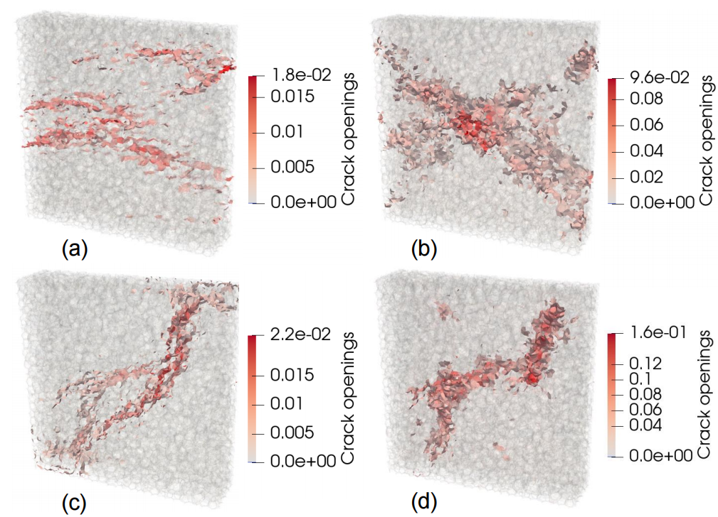
Numerical Results - Validation
Biaxial behavior – cracking pattern
uniaxial tension
uniaxial compression
biaxial tension
biaxial compression

Slide 14
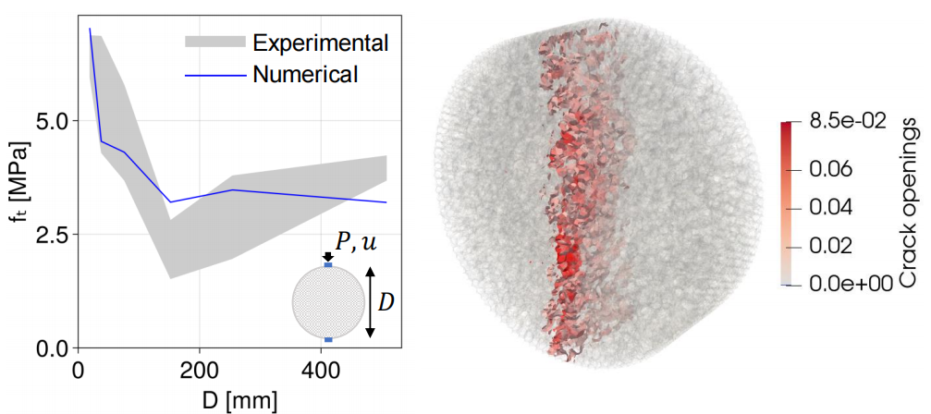
Numerical Results - Validation
Tensile splitting tests
Tested data are from Bazant et al. (1991)
Validation
Parameters are adopted from those calibrated by Cusatis et al. (2011b)
152𝑚
Splitting strength w.r.t. diameter
Cracking pattern

Slide 15
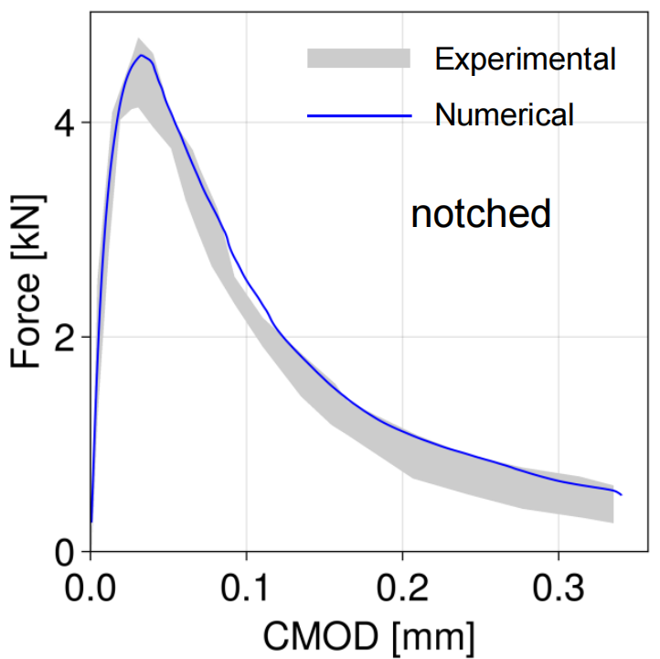
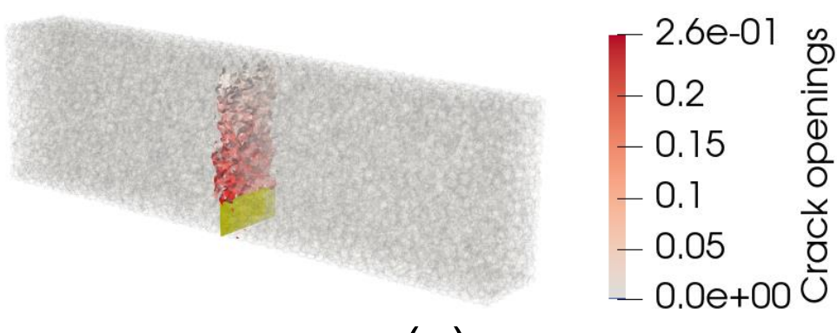
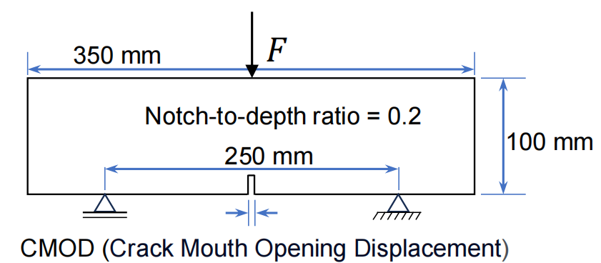
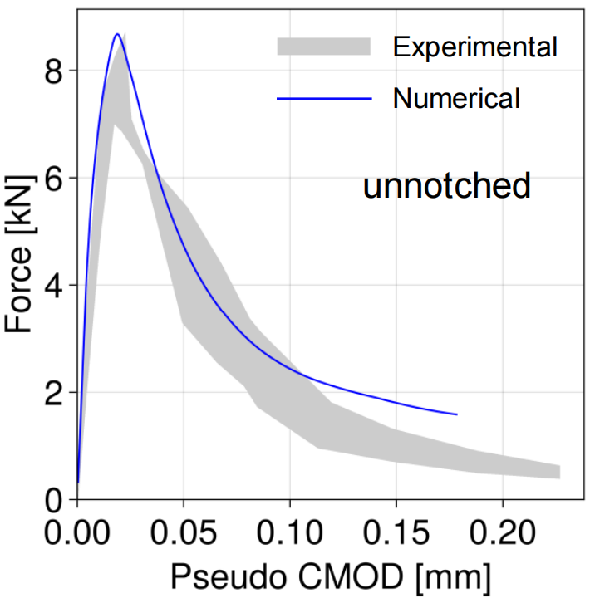
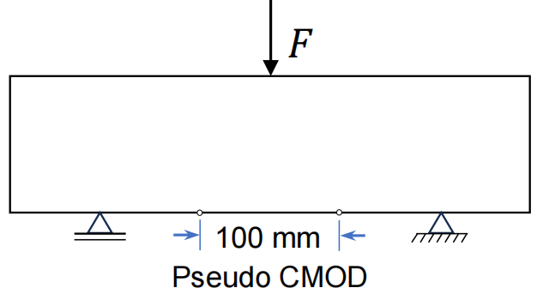
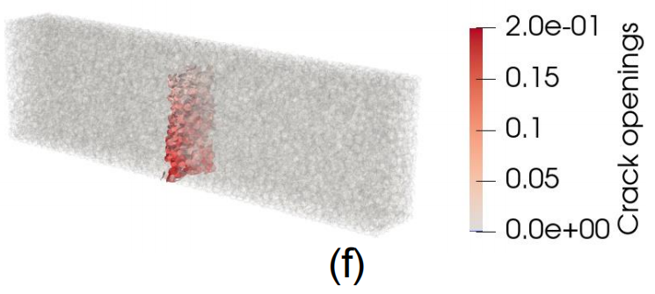
Numerical Results - Validation
Three-point bending tests
Parameter calibration
Tested data are from George et al. (2013)
Validation

Slide 16
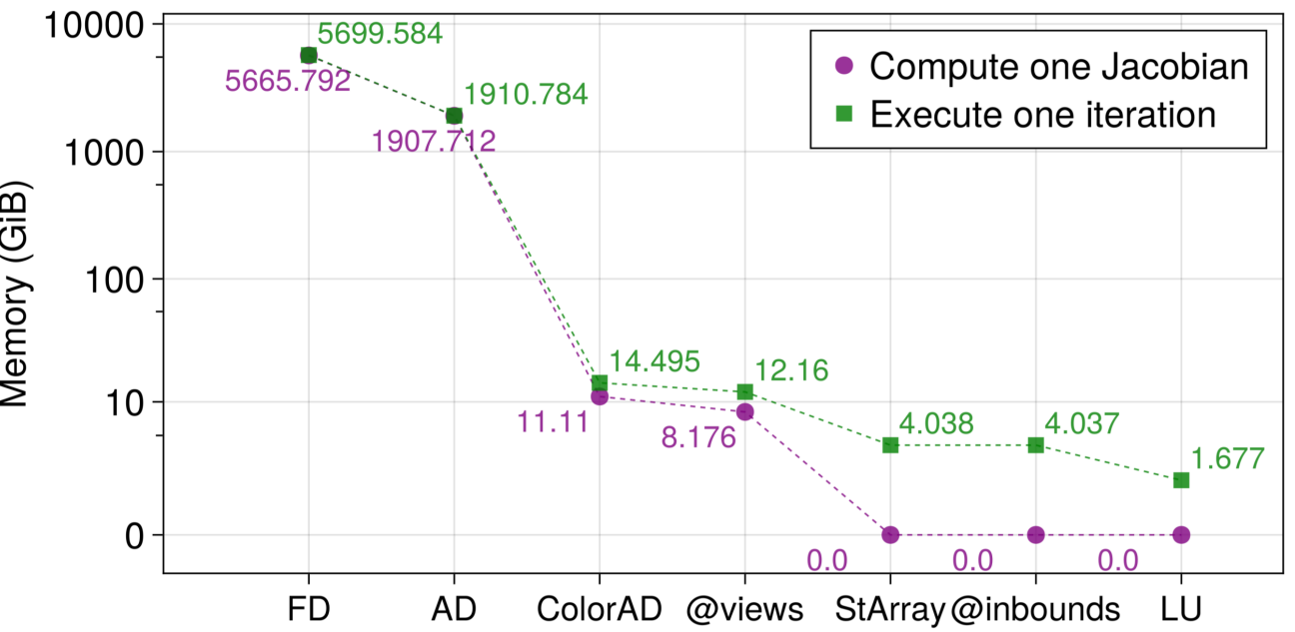
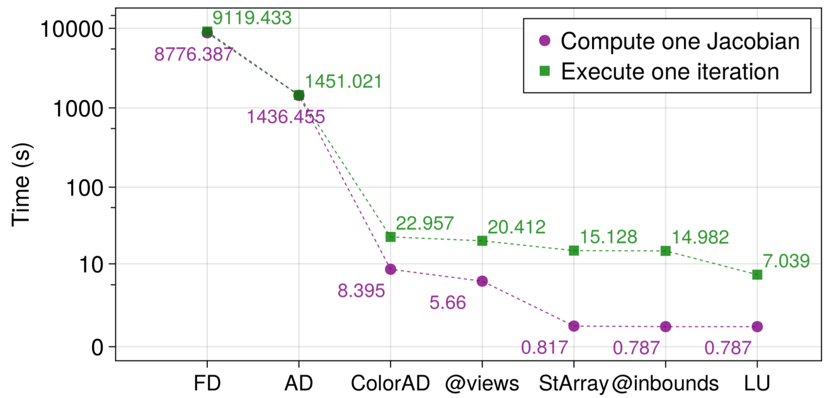
Quantitative Analysis of Model Efficiency
Julia implementation
Effect of progressive inclusion of the different numerical techniques on the computational expense, including: finite difference (FD) calculation of the Jacobian, automatic differentiation (AD), coloring-aided automatic differentiation (ColorAD), @views, StaticArray types (StArray), @inbounds, and symbolic LU factorization.

Slide 17
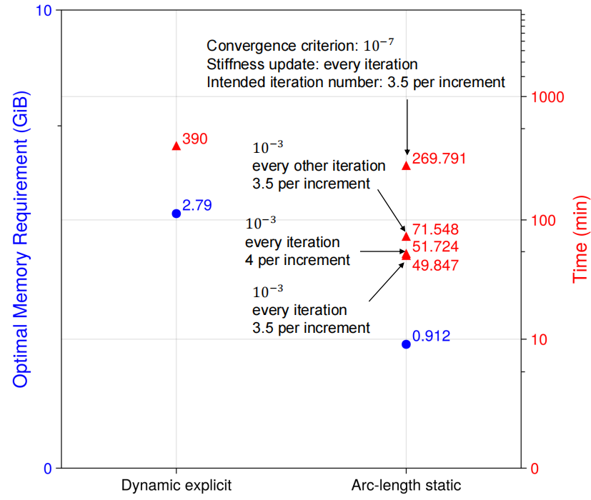
Quantitative Analysis of Model Efficiency
Improvement of computational efficiency for a three-point bending simulation
Pathirage et al. 2022
Both the memory allocation and total computational time required to reach a displacement of 0.15𝑚𝑚 at the loaded point are investigated.

Slide 18
Conclusions
The proposed collaborative criterion to determine the sign of the initial increments of the load factor alleviates convergence issues identified with traditional arc-length methods in the solution of the LDPM governing equations.
Restricting path switch between the unloading-reloading and the stress limit paths at converged points is an effective way to mitigate material instabilities.
A smooth transition between the unloading-reloading path and the stress limit path of elements is required to obtain convergence for macroscopic stress-strain softening branches.
The use of automatic differentiation and graph coloring provides significant improvements in computational efficiency when evaluating the system’s Jacobian matrix.
The proposed static solution exhibits excellent ability to capture the response curves and failure modes of concrete members under unconfined compression, biaxial loading, tensile splitting, and three-point bending.
The proposed implementation achieves 67% reduction in memory requirement and 87% reduction in total computational time when compared to previously available dynamic explicit solutions.

Slide 19
Main References
Jia, D., Brigham, J. C., & Fascetti, A. (2024). An efficient static solver for the lattice discrete particle model. Computer‐Aided Civil and Infrastructure Engineering, under review.
Cusatis, G., Pelessone, D., & Mencarelli, A. (2011a). Lattice discrete particle model (LDPM) for failure behavior of concrete. I: Theory. Cement and Concrete Composites, 33(9), 881-890.
Cusatis, G., Mencarelli, A., Pelessone, D., & Baylot, J. (2011b). Lattice discrete particle model (LDPM) for failure behavior of concrete. II: Calibration and validation. Cement and Concrete composites, 33(9), 891-905.
Cusatis, G., Mencarelli, A., Pelessone, D., & Baylot, J. T. (2010). The Lattice Discrete Particle Model (LDPM) for the Simulation of Uniaxial and Multiaxial Behavior of Concrete: Recent Results. Fracture Mechanics of Concrete and Concrete Structures-Recent Advances in Fracture Mechanics of Concrete, 509-515.
Fascetti, A. (2015). Random lattice particle modeling of fracture processes in cementitious materials (PhD thesis). Sapienza University of Rome, Rome, Italy.
Pathirage, M., Thierry, F., Tong, D., Cusatis, G., Grégoire, D., & Pijaudier-Cabot, G. (2022). Comparative investigation of dynamic implicit and explicit methods for the lattice discrete particle model. In Computational modelling of concrete and concrete structures (pp. 503–509). CRC press.
Kupfer, H., Hilsdorf, H. K., & Rusch, H. (1969, August). Behavior of concrete under biaxial stresses. In Journal proceedings (Vol. 66, No. 8, pp. 656-666).
Bazant, Z. P., Kazemi, M. T., Hasegawa, T., & Mazars, J. (1991). Size effect in Brazilian split-cylinder tests. Measurements and fracture analysis. ACI Materials Journal, 88(3), 325-332.
Grégoire, D., Rojas‐Solano, L. B., & Pijaudier‐Cabot, G. (2013). Failure and size effect for notched and unnotched concrete beams. International Journal for Numerical and Analytical Methods in Geomechanics, 37(10), 1434-1452.
Wang, L., & Li, S. (2014). Capillary absorption of concrete after mechanical loading. Magazine of concrete research, 66(8), 420-431.
Zhang, L., Jia, J., Meng, G., & Zhu, W. (2014). Chloride diffusion in concrete subjected to compressive loading. Magazine of concrete research, 66(19), 991-997.

Slide 20


Acknowledgements
John C. Brigham, Dongge Jia
The Impactful Resilient Infrastructure Science and Engineering (IRISE) funding

